Slide 1

Lok Sabha Elections Insights
By Python
This Photo by Unknown Author is licensed under CC BY

Slide 2
Problem Statement:
AtliQ Media, a private media company, aims to present a unique and unbiased perspective on the upcoming Lok Sabha elections in 2024. Instead of engaging in a predictive debate about potential election winners, AtliQ Media seeks to provide insightful analysis based on data from the 2014 and 2019 Lok Sabha elections.
The focus is to explore less discussed themes, such as voter turnout percentages, demographic trends, regional participation variances, and other key metrics that provide a deeper understanding of electoral behavior in India.
This Photo by Unknown Author is licensed under CC BY

Slide 3
Technical aspects:
Data Cleaning:
Spelling Corrections: Resolve inconsistencies in constituency names and ensure accurate validation.
Post-Bifurcation Adjustment: Assign all constituencies to Telangana after the 2014 bifurcation, including those like Adilabad, Hyderabad, and Warangal.
Data Transformation:
Dimension Tables: Set up appropriate dimension tables with primary keys to enable efficient CSV linkage.
Aggregate Tables: Utilize append and groupby functions to create aggregate tables, improving data query performance.
This Photo by Unknown Author is licensed under CC BY

Slide 4
Questions:
What are the top 5 and bottom 5 constituencies of 2014 and 2019 in terms of voter turnout ratio?
What are the top 5 and bottom 5 states of 2014 and 2019 in terms of voter turnout ratio?
Which constituencies elected the same party for two consecutive elections, ranked by the percentage of votes to the winning party in 2019?
Which constituencies voted for different parties in two elections (list the top 10 based on the difference in winner vote percentage between 2019 and 2014)?
Who are the top 5 candidates based on margin difference with runners in 2014 and 2019?
What is the percentage split of votes of parties between 2014 and 2019 at the national level?
What is the percentage split of votes of parties between 2014 and 2019 at the state level?
What are the top 5 constituencies for the two major national parties where they gained vote share in 2019 compared to 2014?
What are the top 5 constituencies for the two major national parties where they lost vote share in 2019 compared to 2014?
Which constituency had the highest number of NOTA votes?
Which constituencies elected candidates whose party had less than 10% vote share at the state level in 2019?
This Photo by Unknown Author is licensed under CC BY

Slide 5

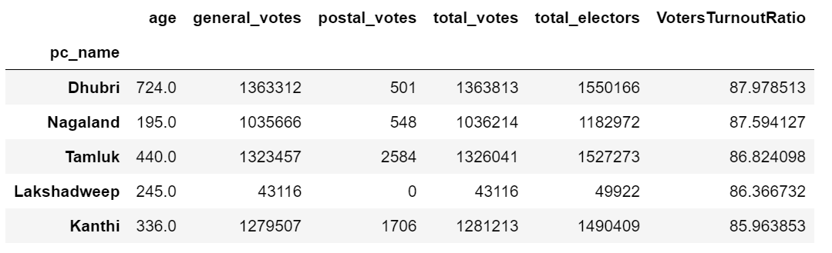
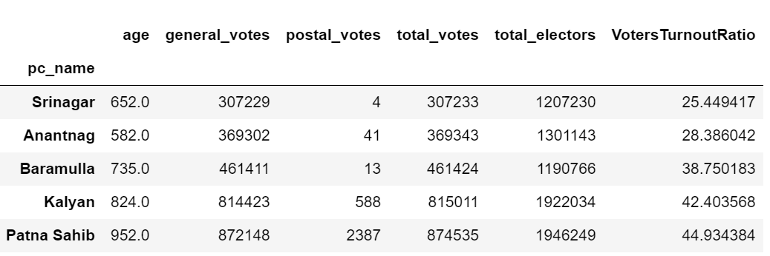
QUESTION 1
What are the top 5 and bottom 5 constituencies of 2014 and 2019 in terms of voter turnout ratio %?
2014
TOP 5
BOTTOM 5
These results indicate a significant disparity in voter turnout between different constituencies in 2014, with high participation rates in areas like Dhubri and Nagaland, while constituencies such as Srinagar and Anantnag experienced much lower turnout
This Photo by Unknown Author is licensed under CC BY-SA

Slide 6
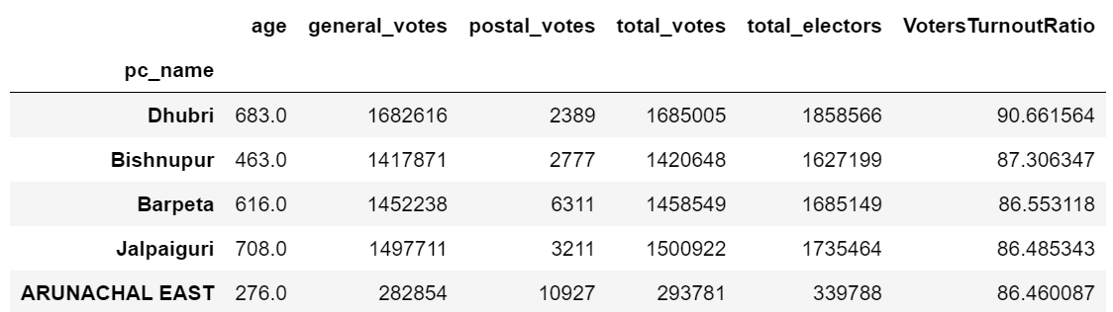
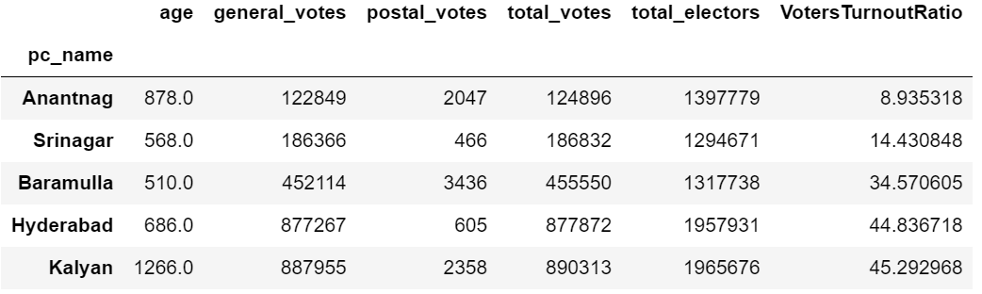
QUESTION 1
What are the top 5 and bottom 5 constituencies of 2014 and 2019 in terms of voter turnout ratio %?
2019
TOP 5
BOTTOM 5
These results reveal a stark contrast in voter turnout among constituencies in 2019, with very high engagement in areas like Dhubri and Bishnupur, while constituencies such as Anantnag and Srinagar had significantly lower turnout.
This Photo by Unknown Author is licensed under CC BY-SA

Slide 7
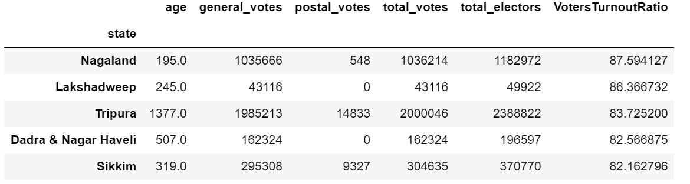
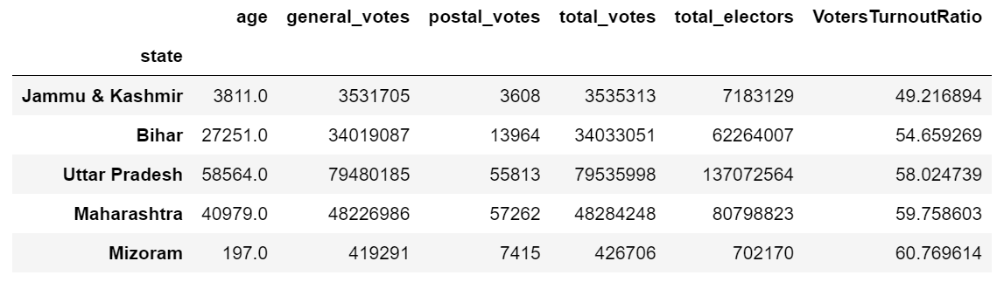
QUESTION 2
What are the top 5 and bottom 5 states of 2014 and 2019 in terms of voter turnout ratio?
2014
TOP 5
BOTTOM 5
These results highlight a significant variation in voter turnout across states in 2014. States like Nagaland and Lakshadweep had notably high participation rates, while regions such as Jammu & Kashmir and Bihar experienced much lower turnout.
This Photo by Unknown Author is licensed under CC BY-SA

Slide 8
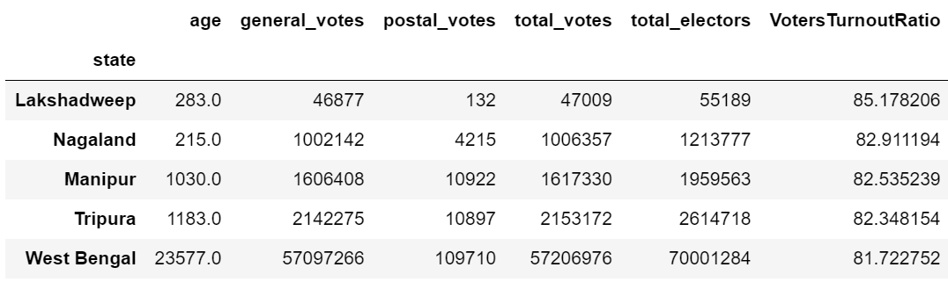
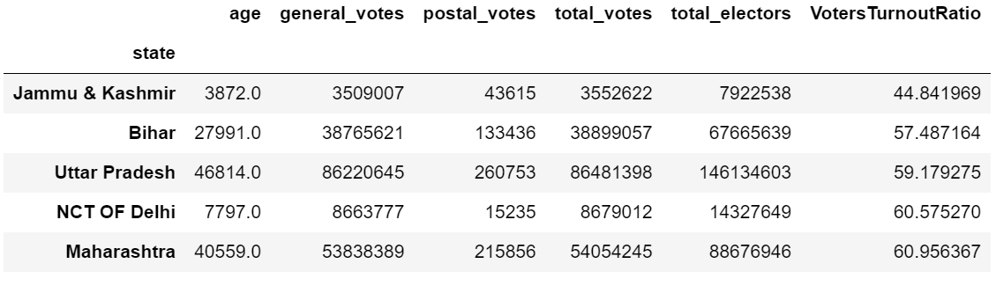
QUESTION 2
What are the top 5 and bottom 5 states of 2014 and 2019 in terms of voter turnout ratio?
2019
TOP 5
BOTTOM 5
This pattern suggests that smaller states and territories generally achieved higher voter engagement compared to larger, more populous states
This Photo by Unknown Author is licensed under CC BY-SA

Slide 9
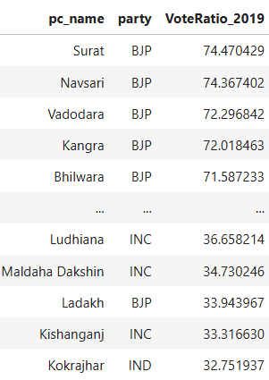
QUESTION 3
Which constituencies elected the same party for two consecutive elections, ranked by the percentage of votes to the winning party in 2019?
In 2019, the top 5 winning parties by percentage of votes are listed, with a total of 336 constituencies re-electing the same party consecutively for the second time in the Lok Sabha elections.
This Photo by Unknown Author is licensed under CC BY-SA

Slide 10
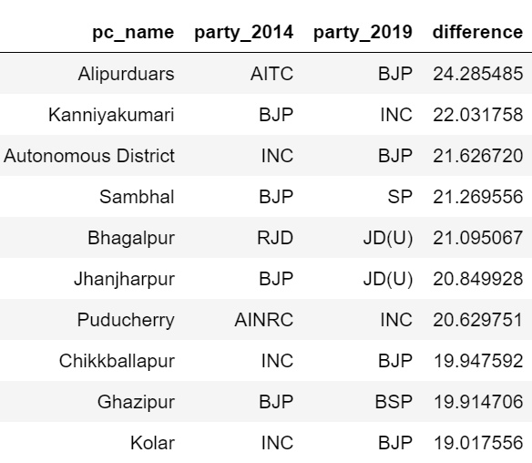
QUESTION 4
Which constituencies voted for different parties in two elections (list the top 10 based on the difference in winner vote percentage between 2019 and 2014)?
The data reveals significant political shifts across various Indian constituencies between the 2014 and 2019 elections. The most dramatic change occurred in Alipurduars, where a 24.29% swing saw the constituency move from AITC to BJP control. Similarly substantial shifts were observed in Kanniyakumari (from BJP to INC with 22.03% difference) and the Autonomous District (from INC to BJP with 21.63% difference). Notable transitions also occurred in constituencies like Sambhal, Bhagalpur, and Jhanjharpur, with margins exceeding 20%. These voting pattern changes reflect broader political realignments during this period, with the BJP and INC being the primary beneficiaries of these shifts, suggesting a dynamic electoral landscape and evolving voter preferences across different regions of India.
This Photo by Unknown Author is licensed under CC BY-SA

Slide 11
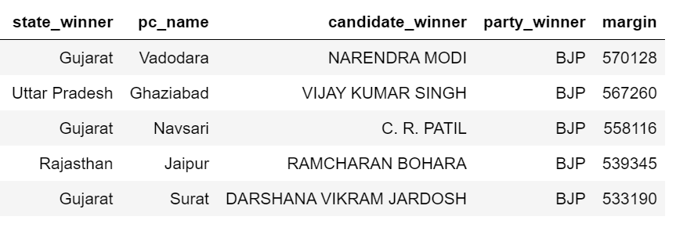
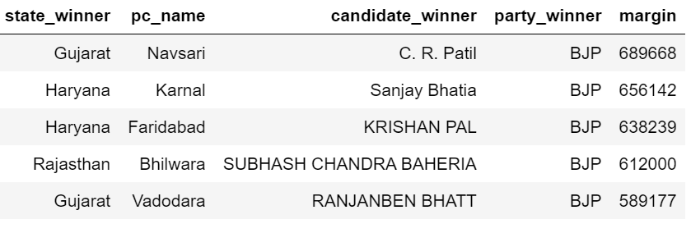
QUESTION 5
Who are the top 5 candidates based on margin difference with runners in 2014 and 2019?
TOP 5 CANDIDATES BY MARGIN IN 2014
TOP 5 CANDIDATES BY MARGIN IN 2019
This trend shows not only BJP's continued stronghold in these regions but also suggests an increasing consolidation of their support base, with winning margins generally increasing from 2014 to 2019, particularly in states like Gujarat and Haryana.
This Photo by Unknown Author is licensed under CC BY-SA

Slide 12
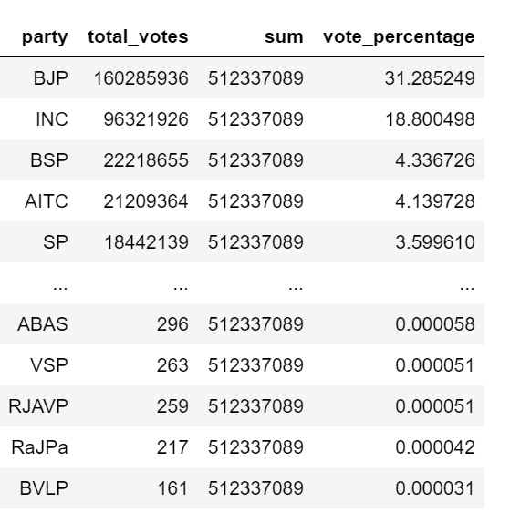
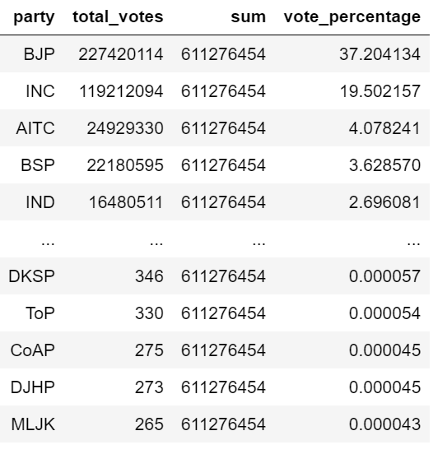
QUESTION 6
What is the percentage split of votes of parties between 2014 and 2019 at the national level?
2014
2019
This Photo by Unknown Author is licensed under CC BY-SA

Slide 13
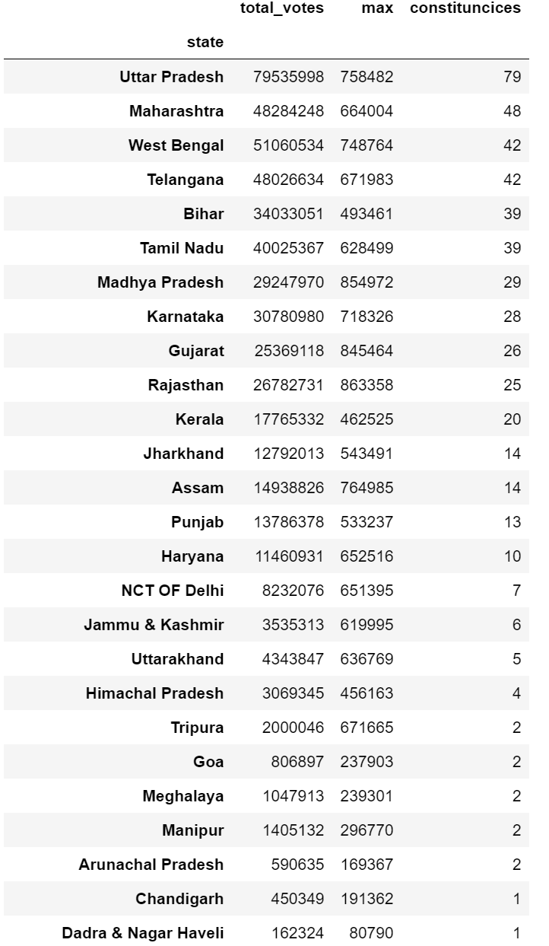
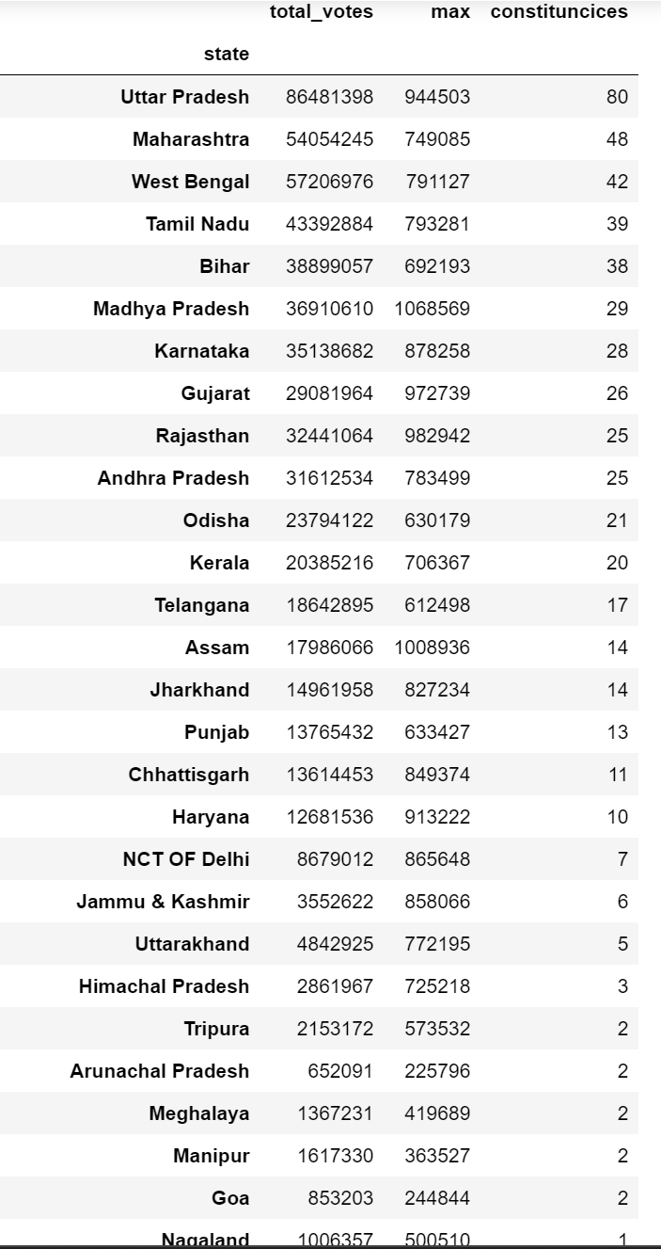
QUESTION 7
What is the percentage split of votes of parties between 2014 and 2019 at the state level?
2014
2019
This Photo by Unknown Author is licensed under CC BY-SA

Slide 14
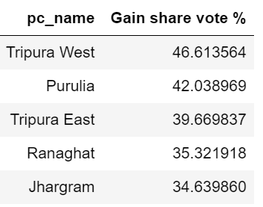
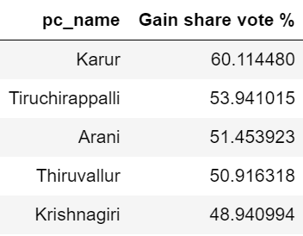
QUESTION 8
What are the top 5 constituencies for the two major national parties where they gained vote share in 2019 compared to 2014?
BJC
INC
This shows that while BJP made its biggest gains in Eastern India (particularly Tripura and West Bengal), Congress saw its largest vote share increases in Tamil Nadu. The data also indicates that Congress achieved higher percentage gains in its top constituencies compared to BJP, with Karur showing the highest overall gain at 60.11
This Photo by Unknown Author is licensed under CC BY-SA

Slide 15
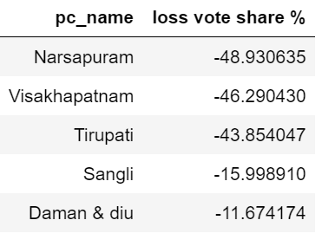
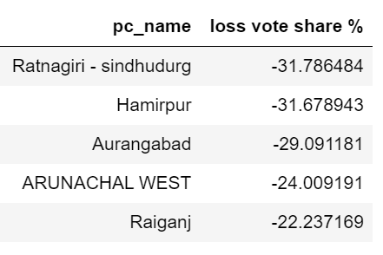
QUESTION 9
What are the top 5 constituencies for the two major national parties where they lost vote share in 2019 compared to 2014?
BJC
INC
The contrast in the magnitude of losses (BJP's largest decline being around 49% versus Congress's 32%) and their geographical distribution indicates different regional challenges faced by each party, possibly reflecting local political dynamics and the rise of regional parties in these areas.
This Photo by Unknown Author is licensed under CC BY-SA

Slide 16
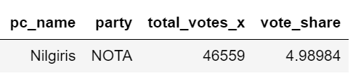

QUESTION 10
Which constituency had the highest number of NOTA votes?
2014
2019
This Photo by Unknown Author is licensed under CC BY-SA

Slide 17
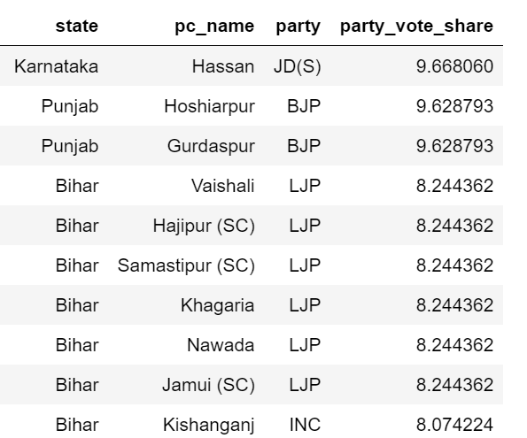
QUESTION 11
Which constituencies elected candidates whose party had less than 10% vote share at the state level in 2019?
Top 10 parties with less than 10% vote share at state level
This Photo by Unknown Author is licensed under CC BY-SA

Slide 18

Conclusion
The analysis of the 2014 and 2019 elections reveals disparities in voter turnout and shifting political preferences across India. Smaller states and constituencies like Dhubri and Nagaland show high engagement, while regions like Srinagar and Anantnag struggle with low turnout. Many constituencies displayed loyalty by re-electing the same party, while others, like Alipurduars and Kanniyakumari, saw major swings, indicating evolving voter preferences.
BJP strengthened its hold in Gujarat and Haryana, while Congress gained vote share in Tamil Nadu. Both parties also faced regional challenges, reflecting the influence of local dynamics and the rise of regional parties. To encourage more representative democracy, efforts should focus on boosting turnout in low-participation areas and addressing regional electoral disparities.
This Photo by Unknown Author is licensed under CC BY-SA-NC

Slide 19
Thank you!
This Photo by Unknown Author is licensed under CC BY

